Slide 1
VISHESHH GLOBE TRADE PRIVATE LIMITED
BRANDING, MARKETING AND PRINTING SOLUTIONS

Slide 2
About Us
VGTPL is a dynamic company managed by professionals who are industry experts in marketing, branding and printing related activities.
We have been a part of the industry for over a decade and specialize in managing branding and marketing elements for our client’s campaigns.
We focus on understanding the exact needs of clients to provide effective & adequate solutions.

Slide 3
Our USP’s
Single point of contact for your entire campaign
Extensive local vendor network across India ensuring on-time, standardised and cost-effective solutions.
Associated with all major mall vendors for hassle free
branding executions in all major malls across India.
Site recces, artwork adaptations, execution, all under one roof!
Direct sourcing locally and globally for special marketing elements and corporate gifting requirements.

Slide 4
Our Service offerings
OUTDOOR BRANDING
Hoardings, Drop-Downs, GSBs, Façade Branding, Pole Kiosks, Arch Gates,
Exhibition Booth Branding & Metal standees.
INDOOR BRANDING
Surface Branding, Sunboard / Flex / ACP / MDF Standees, Clip-on frames, Translites
& Vinyl.
MALL BRANDING
Easel Standees, Pillar Branding, Façade Hoardings, Escalator Branding, Cube branding,
Backlit standee, Totems & Board-Outs
OFFSET
Coupons, Vouchers, Flyers, Brochures, Danglers, Tent Cards, Wobblers, Car Tags,
Specialized Kits, Stickers, Head Bands / Crowners, POS Rolls & Paper Prints.

Slide 5
Our Service offerings
FABRICATION & INSTALLATION
Highway Hoarding Structure, Heavy Metal Standee, Floor Standee Units, Directional GSBs,
ACP Standee, Podiums, Canopy, Promo tables & Garden Umbrellas.
CORPORATE GIFTING & MERCHANDISING
Diaries, Books, Gift sets, Pens, Mugs, Cotton T-Shirts, Personalised Mementos, Customised Gift sets, Certificates, Gift bags, Aprons, Tea Coaster, Paper Weights, Fridge Magnets, Wrist Bands & Badges.
BACKEND ACTIVITIES
Site recces, Artwork adaptations, Remote Location Installations, Delivery & Installation Coordination.

Slide 6
Execution Images
In the following slides we have incorporated just a handful of execution images for your reference to maintain a reasonable data size for this presentation.
Since the product range is widespread and we have numerous types of work that can be executed, we can share many more reference images based on your requirement.
Please share your specific requirements and we shall be glad to share the appropriate references.

Slide 7
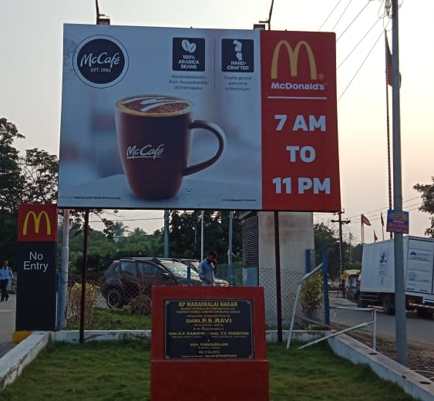
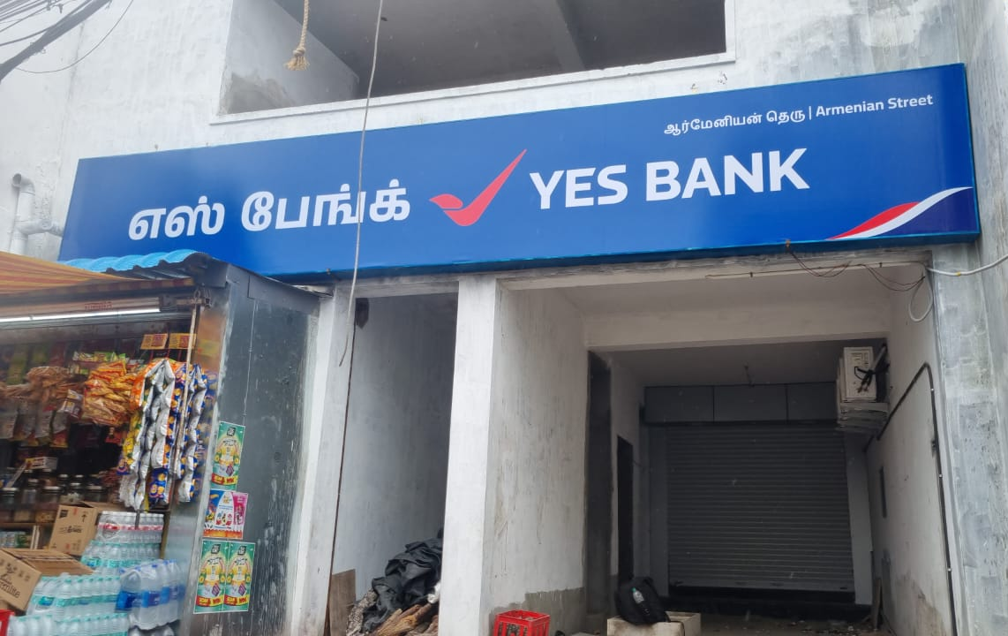
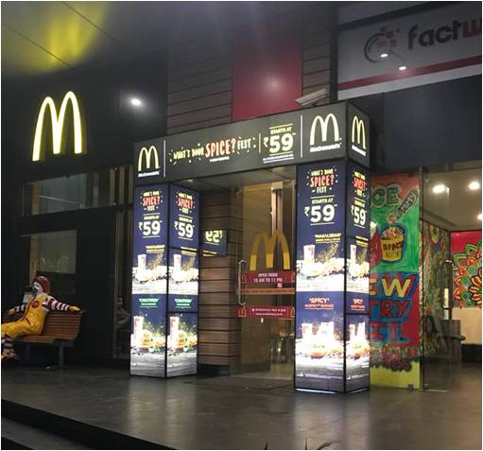
OUTDOOR BRANDING
ART
PATTERN

Slide 8
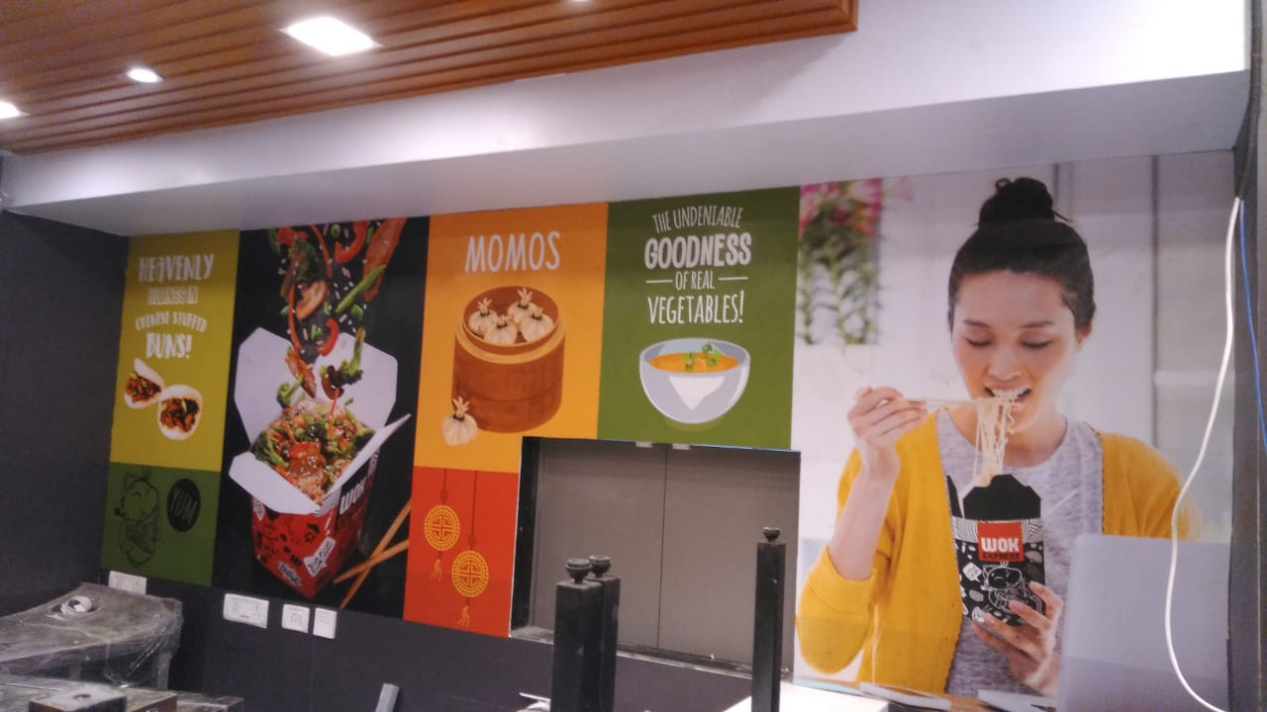
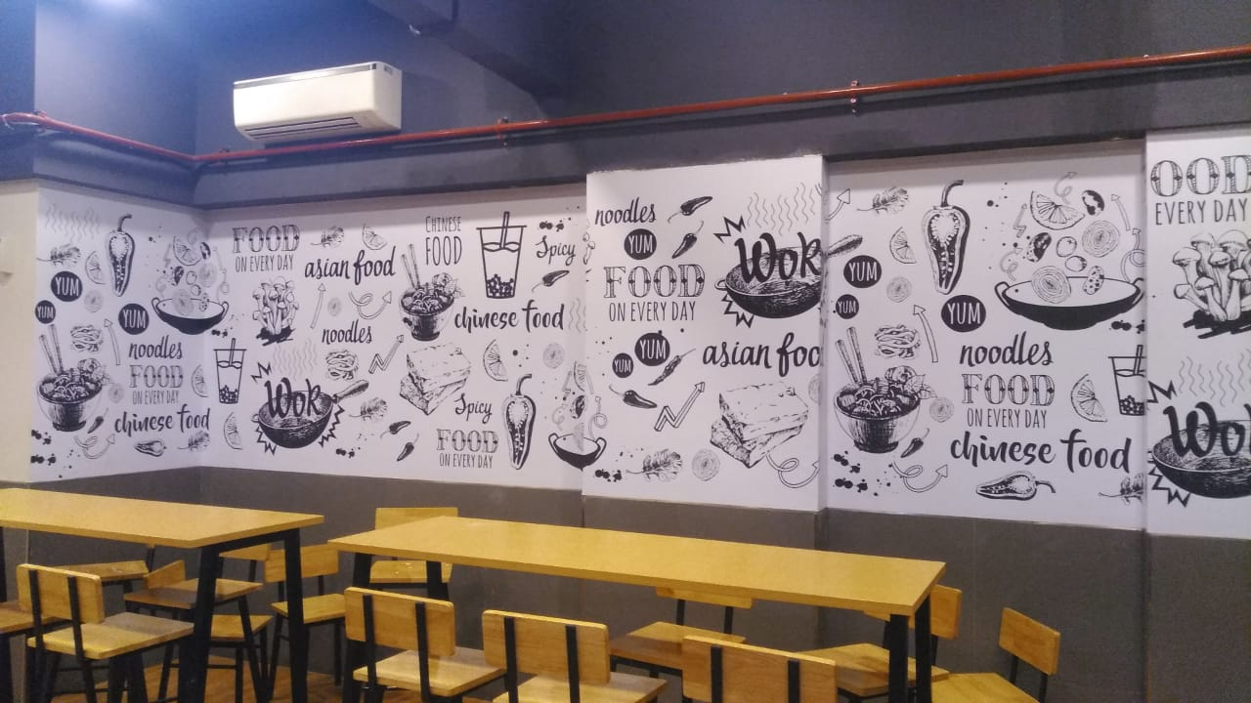
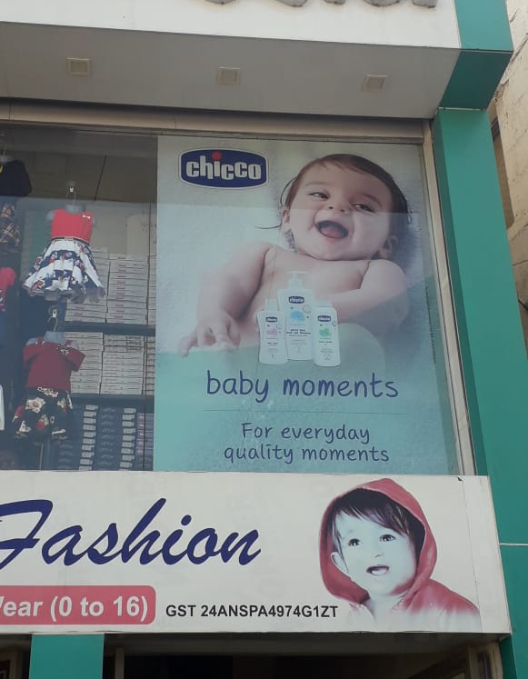
INDOOR (INSHOP) BRANDING

Slide 9
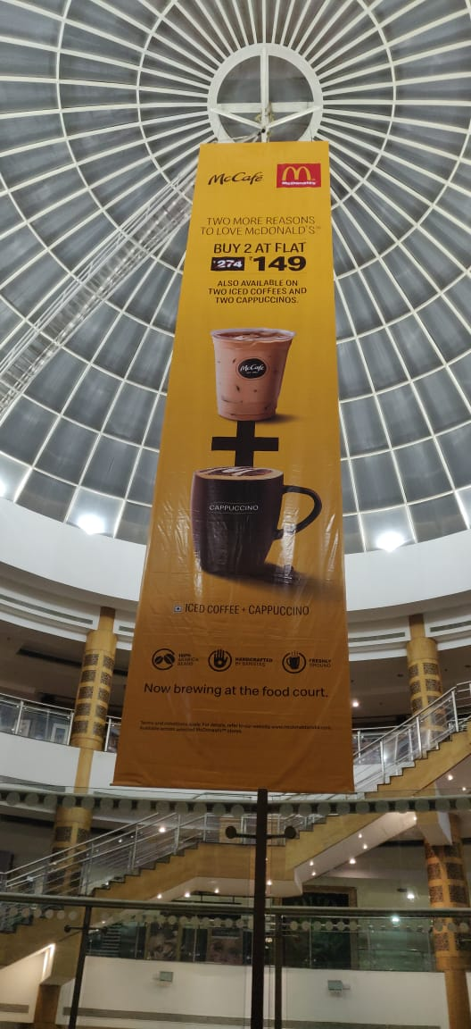
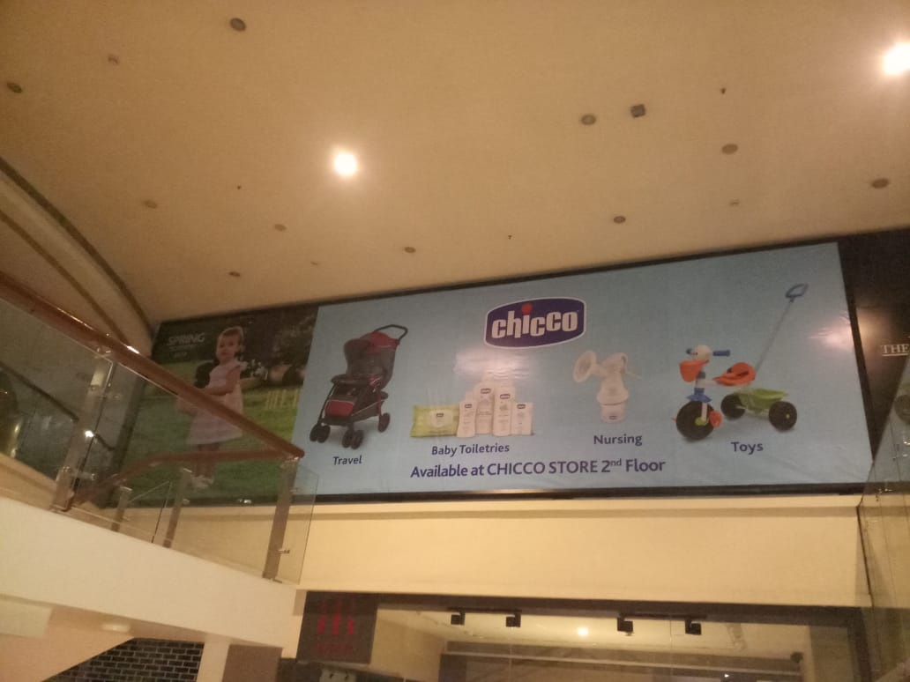
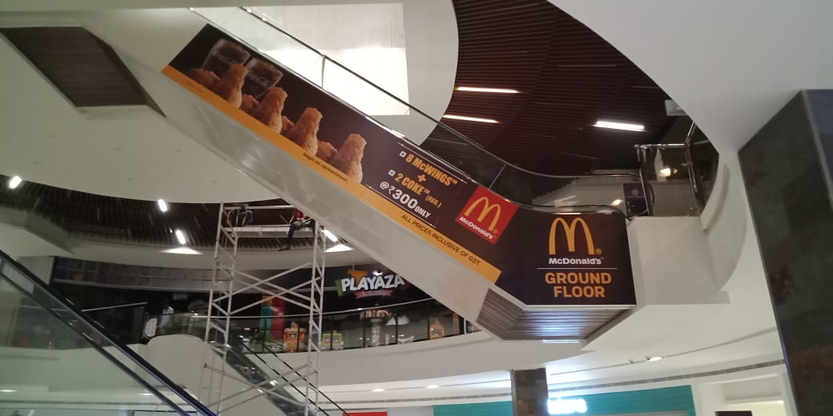
ART
PATTERN
MALL BRANDING

Slide 10
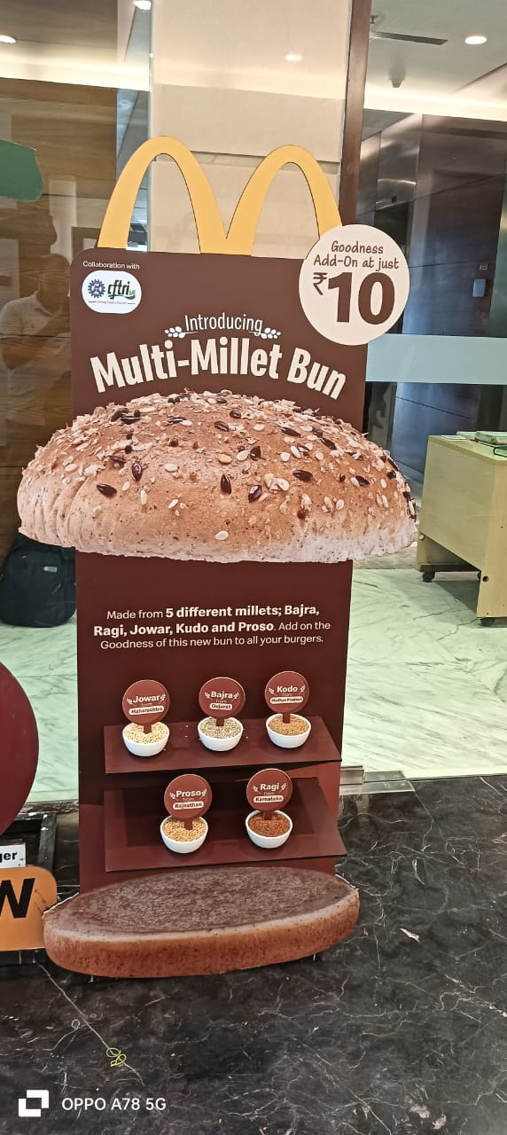
ART
PATTERN
BIG STANDEE

Slide 11
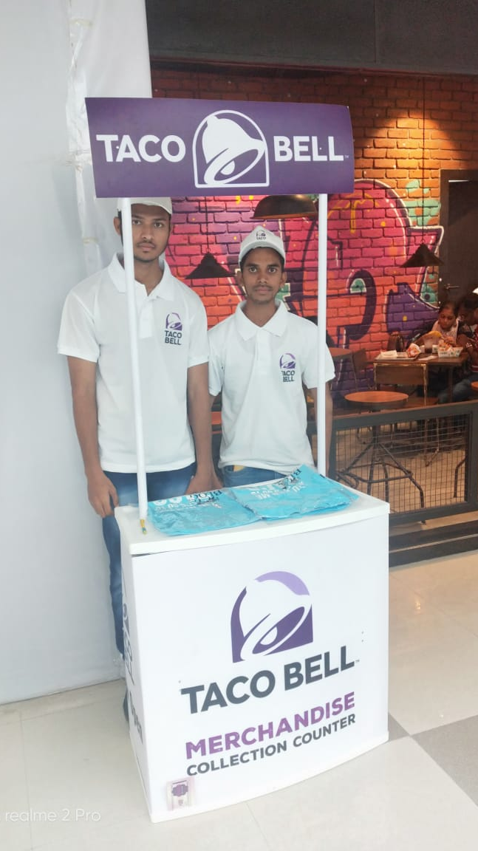
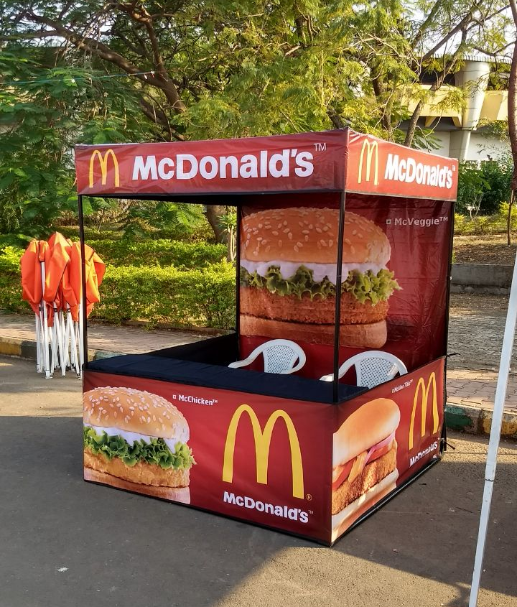
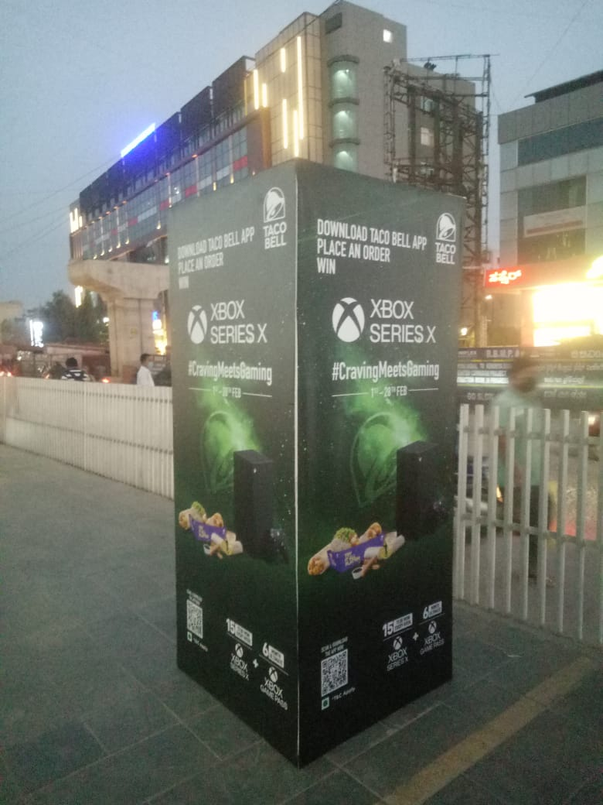
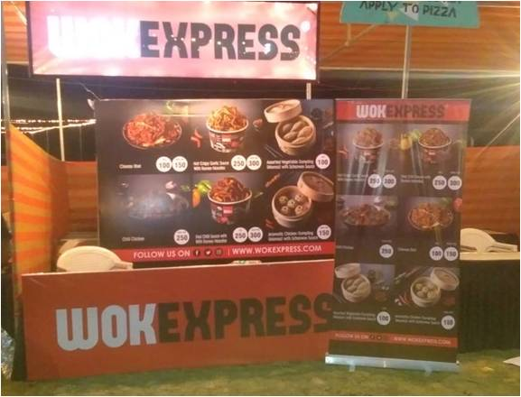
LSM BRANDING
ART
PATTERN

Slide 12
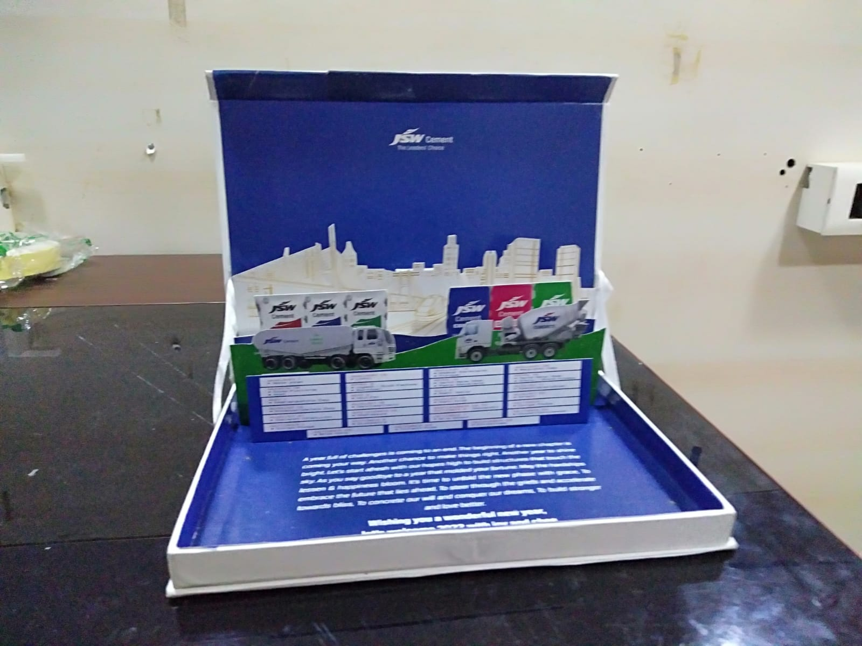
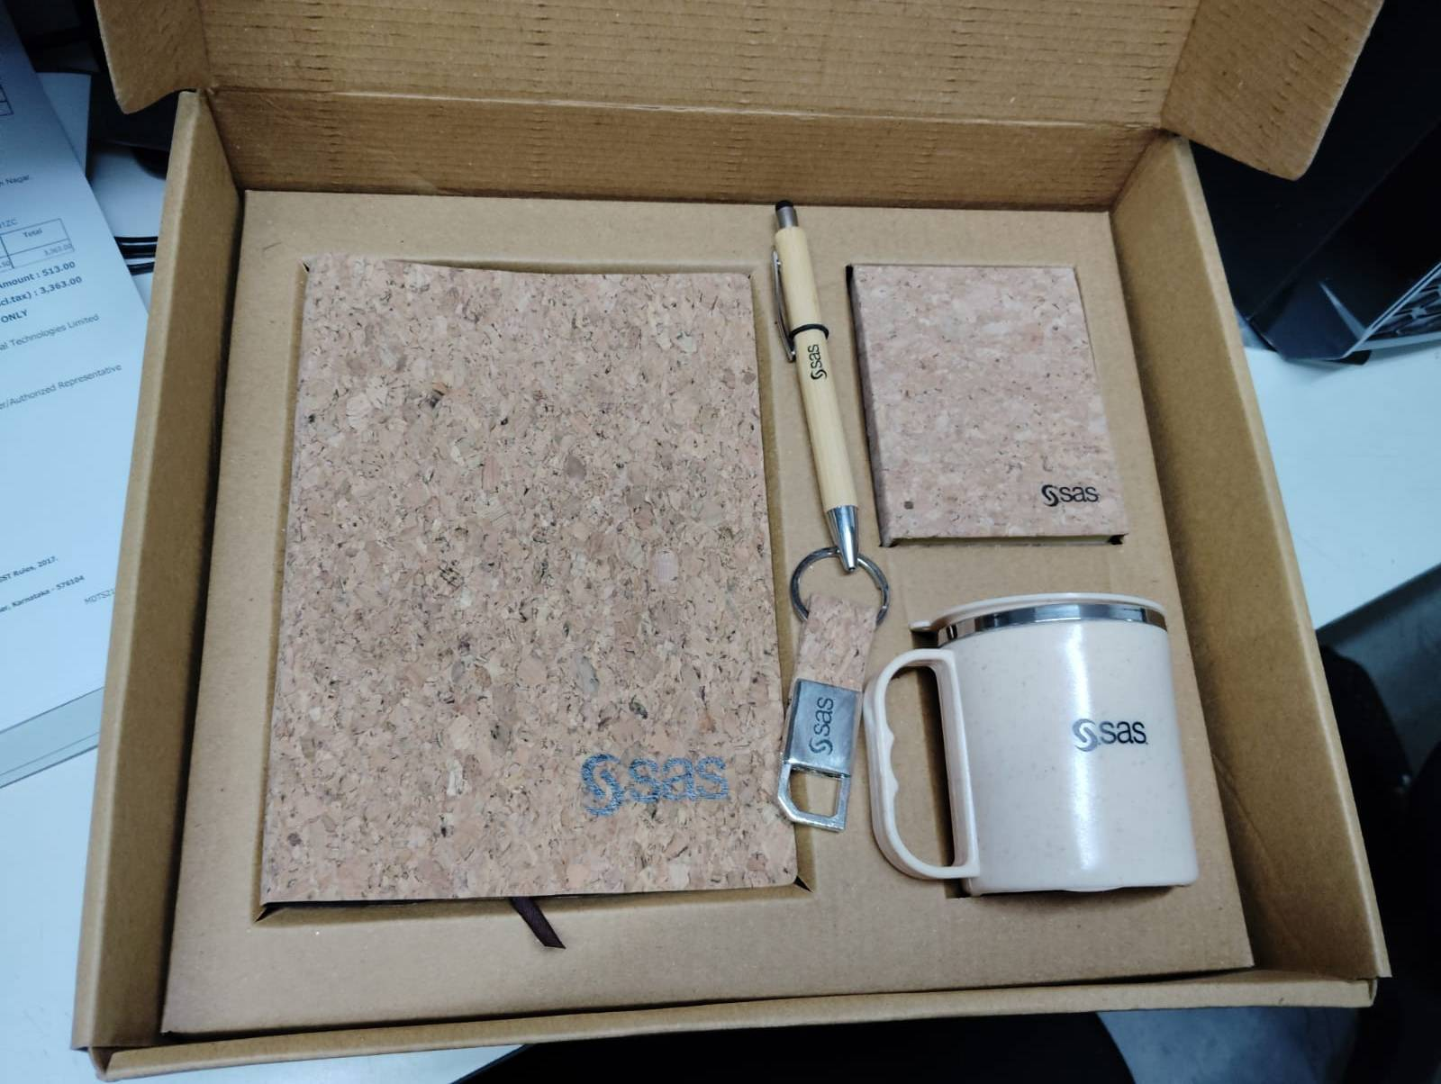
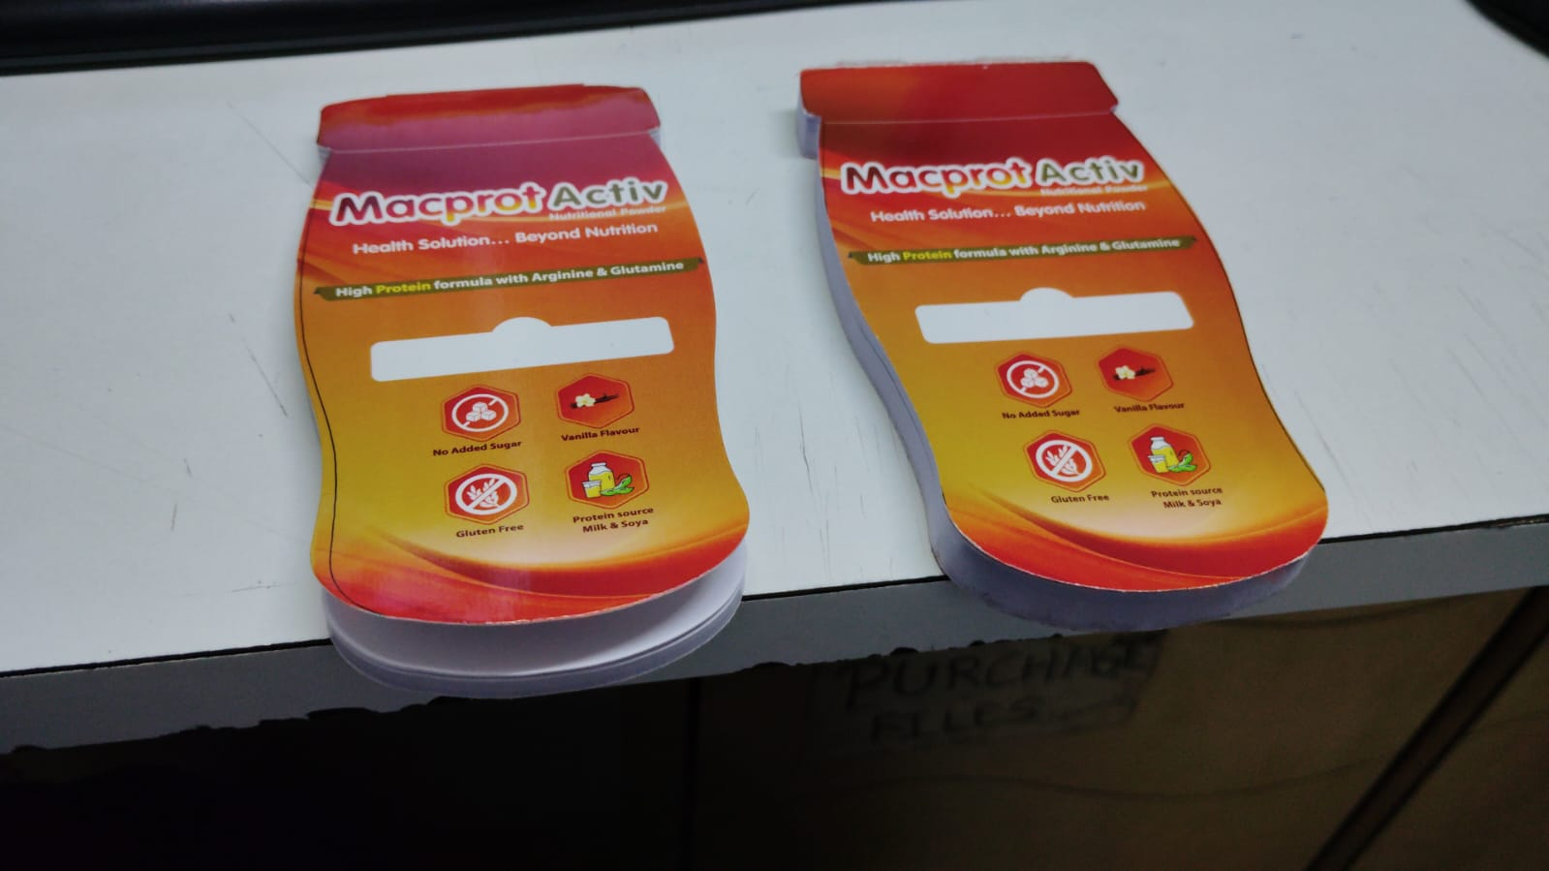
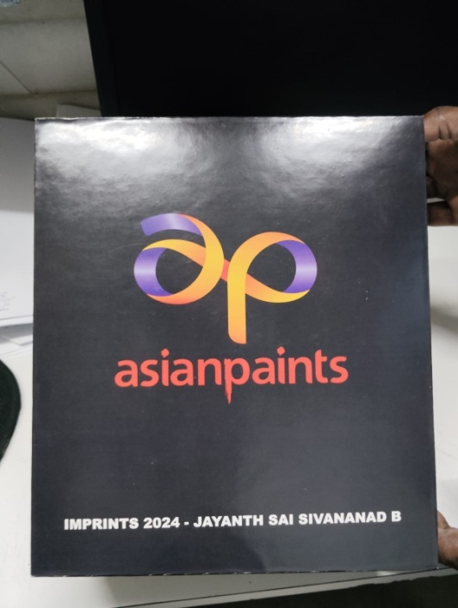
CORPORATE GIFTING
ART
PATTERN

Slide 13
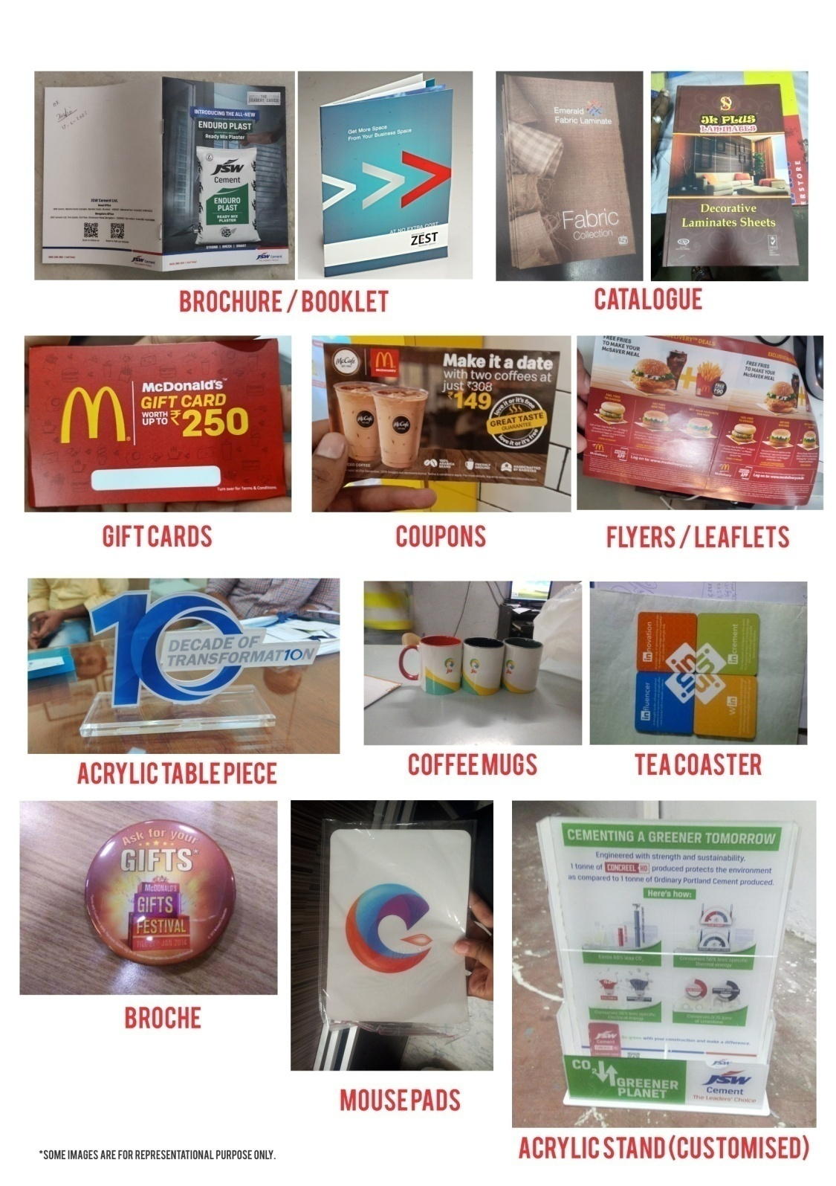
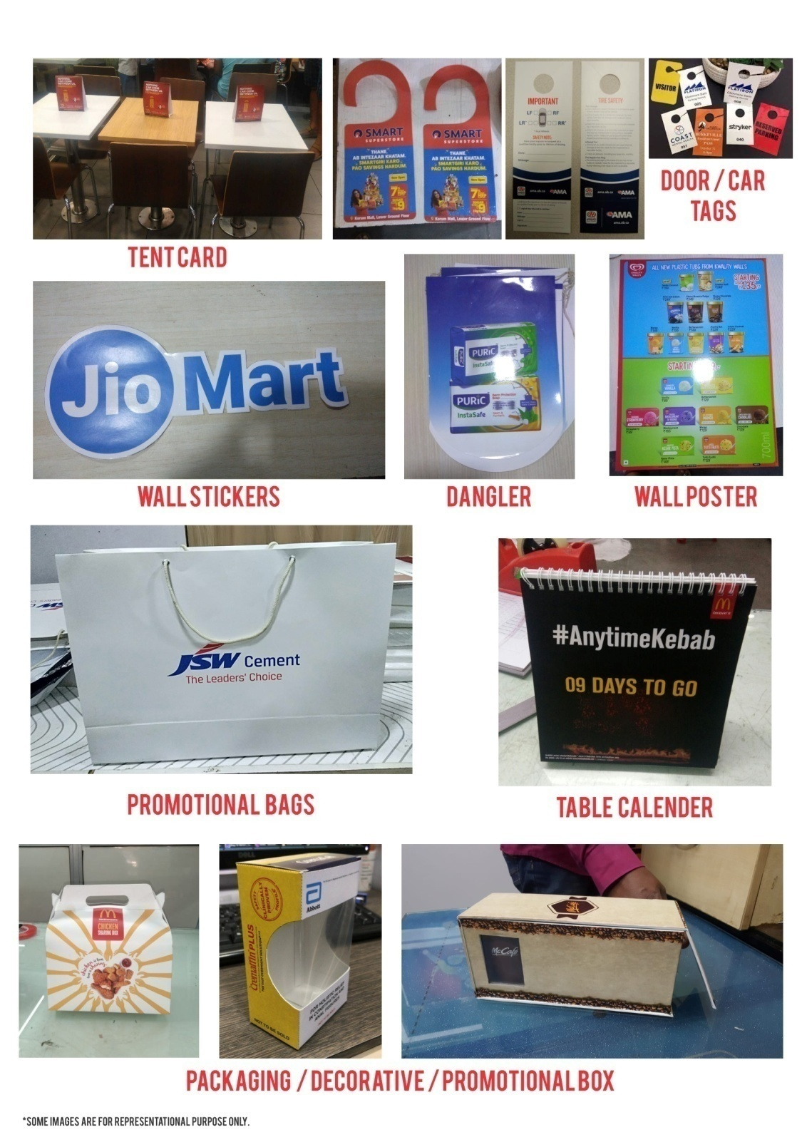
MERCHANDISING ITEMS

Slide 14
Our clients
You may recognize some of our esteemed clients! We would be glad to share references, if required.

Slide 15
Contact Us
Corporate Office: 1007, 10th Floor, Dalamal House,
Nariman Point, Mumbai 400021
Tel: 022-22028136
Mobile: Visheshh Jatiaa - 80822 52842 / 98333 50822
Vibhor Goel - 9833011388
Email: visheshhglobeprinting@gmail.com
Please contact us for any requirements. We look forward to working with you!
THANK YOU!

